Slide 1

B18 Lesson 7
Bishop Stopford School
faith | justice | responsibility | truth | compassion
ONLINE LEARNING
Learning Objectives
Retrieval
Acquire
Action
Review
Dig Deeper

Slide 2
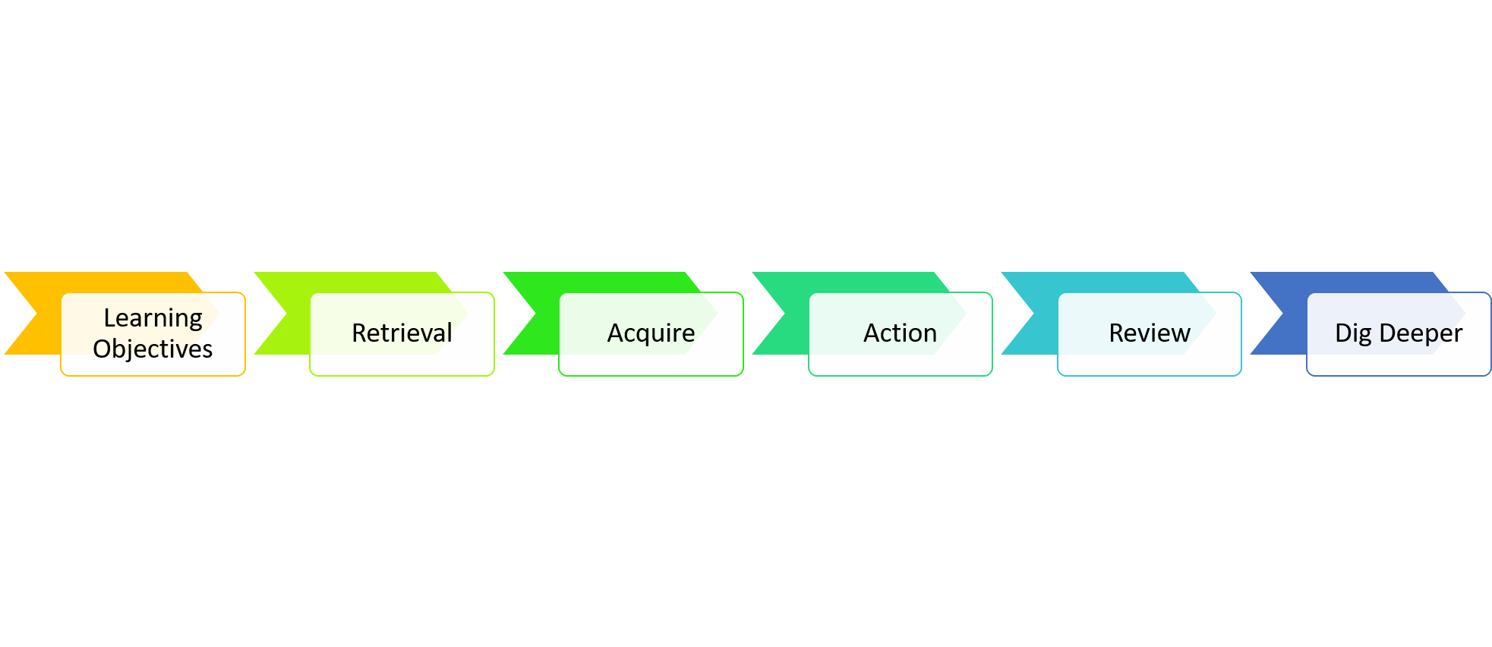
Food
Learning Objectives
1)State what is meant by food security
2)Describe reasons food security is being threatened
3)Explain ways of improving the efficiency of food production

Slide 3
Starter – Reminder from last lesson
1) What is Biomass?
2) What is a trophic level?
3) Why does biomass (and the energy contained within it) decrease as you go along a food chain)?

Slide 4
Starter – Answers
What is Biomass?
The dry mass of an organism
2) What is a trophic level?
The stage of a food chain
3) Why does biomass (and the energy contained within it) decrease as you go along a food chain)?
Not all the food can be digested and absorbed – some is lost as faeces
Some of is used in respiration to release energy. This energy is used for living processes (e.g. movement, maintaining body temp.)
Biomass is lost in waste products of metabolism (e.g. carbon dioxide, water, urea)

Slide 5
Videos
To keep to schedule there is a lot of new content that we are going to try and cover this lesson. For this reason there are 4 videos to watch this lesson, each on a different area:
Video 1: Food security
Video 2: Modern Farming
Video 3: Sustainable Fishing
Video 4: Role of biotechnology in food production,

Slide 6


Watch video 1
You can watch this video as many times as you want to

Slide 7
Watch video 2
You can watch this video as many times as you want to

Slide 8
Watch video 3
You can watch this video as many times as you want to

Slide 9
Watch video 4
You can watch this video as many times as you want to

Slide 10
Key Notes
Food security is having enough food to feed a population. Factors which are threatening food security include:
• the increasing birth rate
• changing diets in developed countries means scarce food resources are transported around the world
• new pests and pathogens that affect farming
• environmental changes that affect food production, such as widespread famine occurring in some countries if rains fail
Methods to protect our food security:
• Reducing the number of stages in food chains
•limiting the movement of farmed animals
•controlling the surrounding temperature of farmed animals
•Growing new types of foods (e.g. the fungus Fusarium is used to produce mycoprotein, a protein-rich food suitable for vegetarians)
•Genetically modifying crops
•Ensure our fishing method are sustainable

Slide 11
Task – Food exam questions
Complete self-assess the exam questions. Write a score, WWW/EBI.
https://bishopstopford.fireflycloud.net/science-2/school-closure-tasks/year-10-1/biology/triple/b18-biodiveristy-and-ecosystems

Slide 12

Review
Complete the following interactive kerboodle task to review the content of this lesson
https://www.kerboodle.com/app/courses/19899/modules/Resources/node/15831/page/1/content/154388

Slide 13
Dig deeper (optional)
Some people believed that if everyone was vegan it would be better for our environment and our food security. Watch the video below and then write your opinion - should everyone be vegan?

